Slide 1
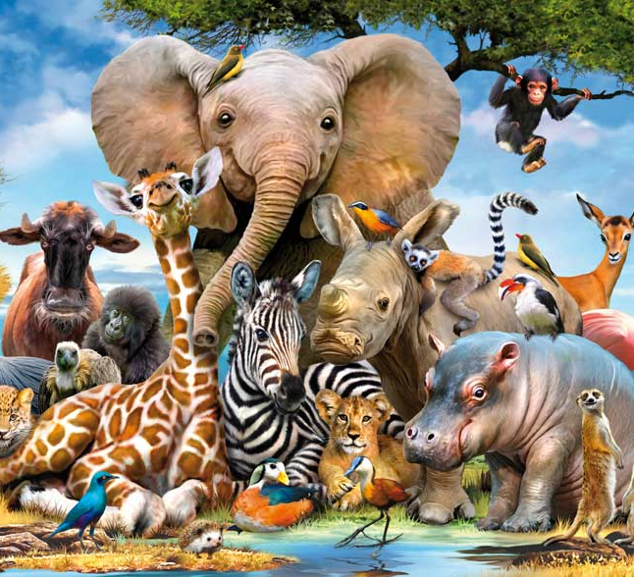
ANIMALS (CLASS 10)
Prepared By:
Anuradha Mathur

Slide 2

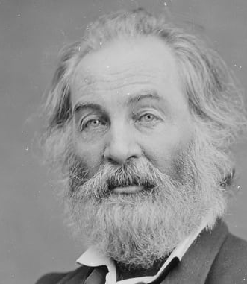
ABOUT THE POET
Walt Whitman (1819-1892) is a major figure in early American poetry. He broke the tradition of rhymed and metrical poetry. He was famous for writing a revolutionary new kind of poetry which was in free verse. The poem ‘animals’ is from his work ‘Song of Myself’ in Leaves of grass.

Slide 3
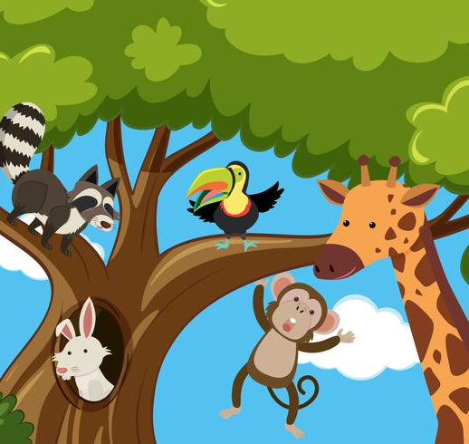
INTRODUCTION
Walt Whitman has shown the comparison between human beings and animals in his poem. He has pointed out the evils present inside the human brain which he thinks animals don’t have. That is why he thinks that animals are much better than human beings.

Slide 4
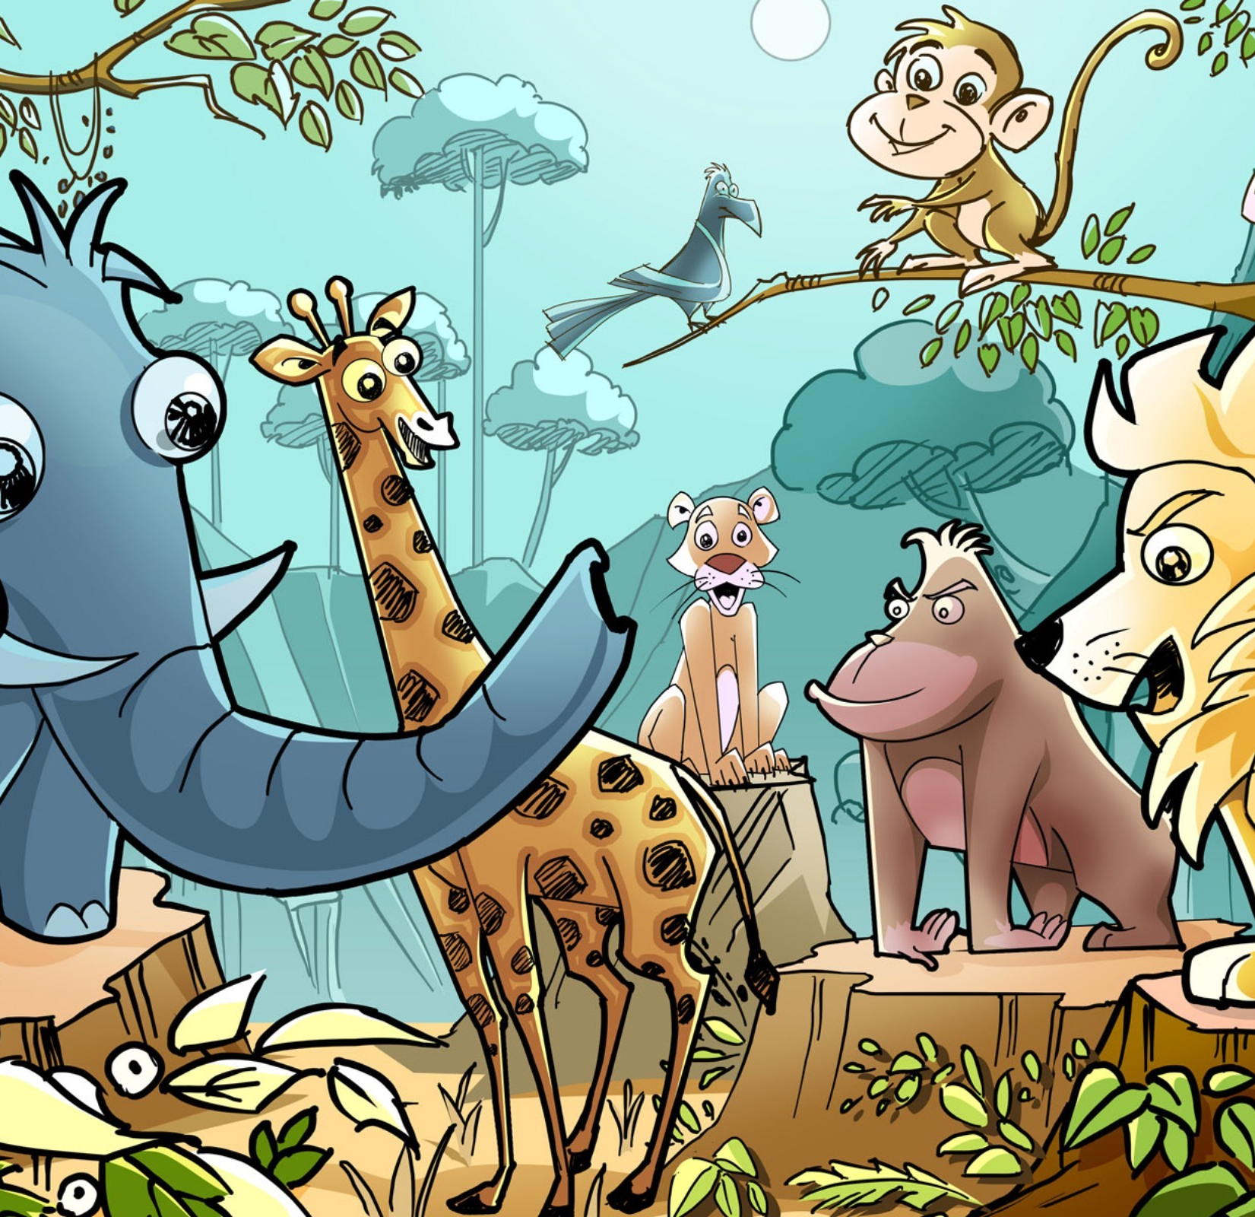
SUMMARY
In the poem animals, the poet has described his will to become an animal because he thinks animals are far better than human beings. Human beings are greedy and full of jealousy against each other. But animals are calm and self contained. The animals are happy with what they have. They never complain about miseries and sorrows. On the other hand human beings complain about their miseries. They give more importance to the rich and strong people, stay restless because of their wrongdoings and run behind the luxurious things of this world. Whereas animals are honest about their relations and don’t give importance to a particular class. They live a life which is full of honesty and less of greed and jealousy.

Slide 5


STANZA 1
I think I could turn and live with animals, they are
so placid and self-contain’d,
I stand and look at them long and long.

Slide 6

EXPLANATION
The poet says that he wants to live in the world of animals. Here we can say that the poet finds the world of animals better than that of human beings. He further says that he finds animals more peaceful than humans. He says so because animals are not running after worldly things like human beings. They are calm and have no greed for worldly things or any kind of achievements. They are self contained means they are happy with life and never interfere in the lives of others. Humans have the habit of interfering in the lives of others. So, poet thinks that animals are better than humans for being calm and not interfering in the matters of others. The poet further says that these are the reasons why he stands still and looks at the animals for a very long time.

Slide 7
LITERARY DEVICES
Assonance: use of vowel sound ‘I’ (I, think, I, live, with, animals) Repetition: use of the word ‘long’
Anaphora: ‘I’ word used at the start of two consecutive lines

Slide 8
STANZA 2
They do not sweat and whine about their condition,
They do not lie awake in the dark and weep for their sins,
They do not make me sick discussing their duty to God,
Not one is dissatisfied, not one is demented with
the mania of owning things,
Sweat: here it means complaint

Slide 9
EXPLANATION
The poet says that unlike humans, animals don’t complain of any misery. They never cry out loud like humans do, to show what they have lost. They never stay awake in the night, crying in repentance for their wrongdoings. This means that animals are different from human beings because they don’t show anger or grief if something wrong happens with them. He further says that animals are very truthful because they never boast of their good deeds done in the name of god. He says so because most of the human beings do this. They try to show their good deeds and religiousness to others. They do so in order to gain popularity among their fellows. So, the poet thinks that animals never irritate him by doing such things just to gain some praise from their fellow people. He feels that the animals are not dissatisfied like humans. They stay happy with whatever they have. They never run behind worldly things. They never try to possess things of comfort or luxury. He says that none of them is mad behind owning the worldly things.

Slide 10
LITERARY DEVICES
Anaphora: use of repeated words at the beginning of two or more consecutive lines (use of “they do not”)
Metaphor: sweat and whine refer to the cries and complaints of human beings

Slide 11
STANZA 3
Not one kneels to another, nor to his kind that lived thousands of years ago, Not one is respectable or unhappy over the whole earth. So they show their relations to me and I accept them, They bring me tokens of myself, they evince them plainly in their possession

Slide 12
EXPLANATION
Here the poet says that he has never seen any animal showing his devotion to anyone by bowing down in front of the person. They never do so even for their ancestors. They do not show devotion towards God like humans do. No one among them is more respectable or important as we have in human society. In human beings, rich people are generally given more importance and are treated with more respect as compared to the poor. But in the society of animals, they never do so. They never give more or less importance to any other animal. Everyone in the animal world is happy. They are not like human beings who find themselves the happiest or the saddest person on earth. Further the poet says that animals are more honest in showing their relations with other animals. Here he wants to say that animals use other animals as their food and they never try to hide this. Whereas human beings show that they have nice and friendly relations with others, though the reality is opposite. The poet says that he accepts the fact that animals are true towards showing their relation with other animals.

Slide 13
LITERARY DEVICES
Metaphor: The inner qualities of humans are referred to as tokens

Slide 14
STANZA 4
I wonder where they get those tokens,
Did I pass that way huge times ago and negligently drop them?

Slide 15
EXPLANATION
So at last the poet introspects himself and says that from where the animals got those good qualities. He further questions himself that where his own good qualities are gone? Did he left them or had carelessly lost them somewhere. The qualities that were found in human beings in the past, like innocence, kindness, truthfulness are now seen in animals. He wonders that humans gave up these qualities and they have been passed on to the animals.

Slide 16



